Slide 1

Student Performance Analysis
Data-Driven Insights for Education
Presented by M. Faseeh U Din Paracha

Slide 2
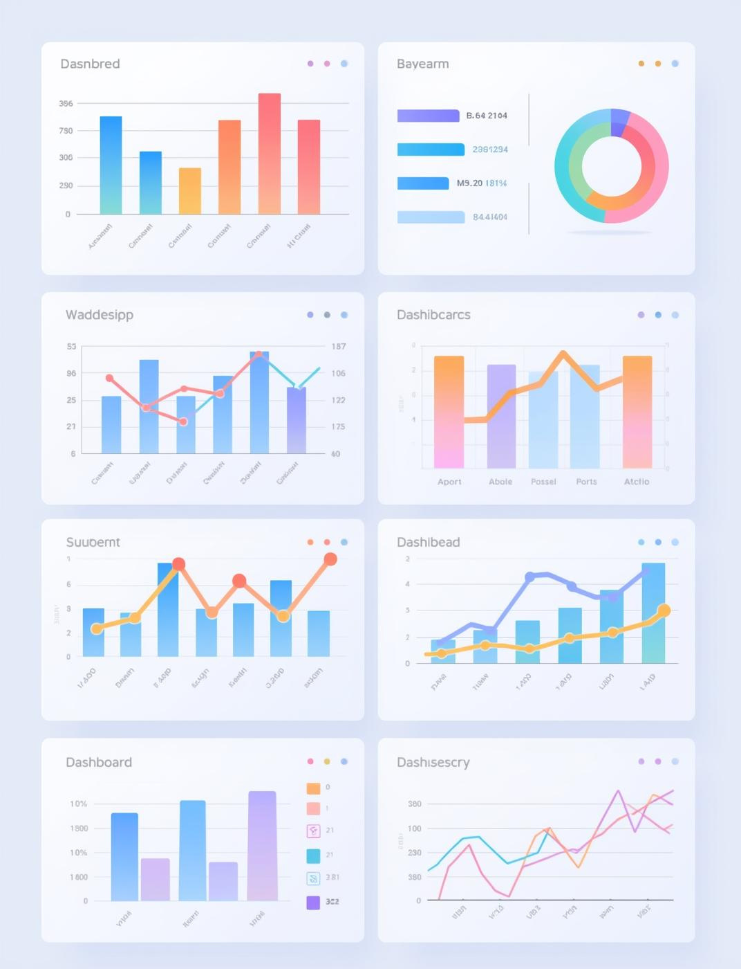

Introduction & Problem Statement
  Educational institutions generate large volumes of student data
  Manual analysis is time-consuming and error-prone
  ICT and AI tools help automate analysis and improve decision-making
  This project demonstrates an AI-integrated ICT solution for performance analysis

Slide 3
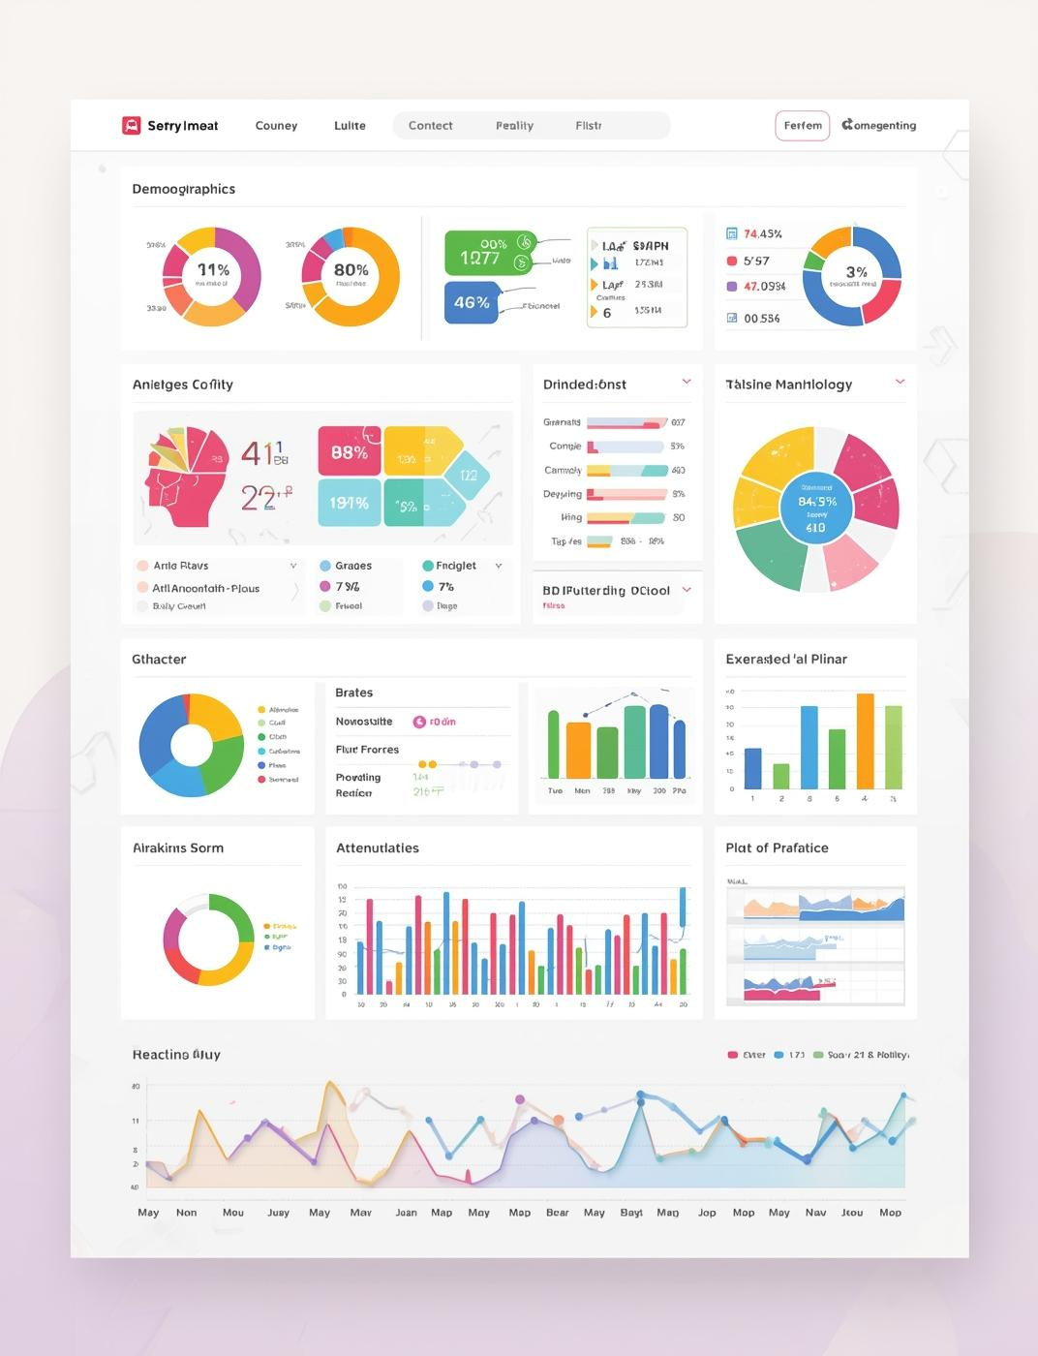
Dataset Overview
Dataset Overview
  20 student records
  Subjects: ICT, PF, Mathematics
  Attributes: Quiz, Assignment, Mid, Final, Total, Average, Status
AUTOMATION USING EXCEL MACROS
  Recorded macros to automate repetitive tasks
  Header formatting and conditional formatting automated
  Macro assigned to a button for easy execution
  Reduced manual effort and errors

Slide 4
Excel Analysis
01
02
03
Formulas and Functions
Conditional Formatting
Macros for Automation
Use averages and IF statements efficiently.
Highlights performance variations at a glance.
Streamlines repetitive tasks for efficiency.

Slide 5
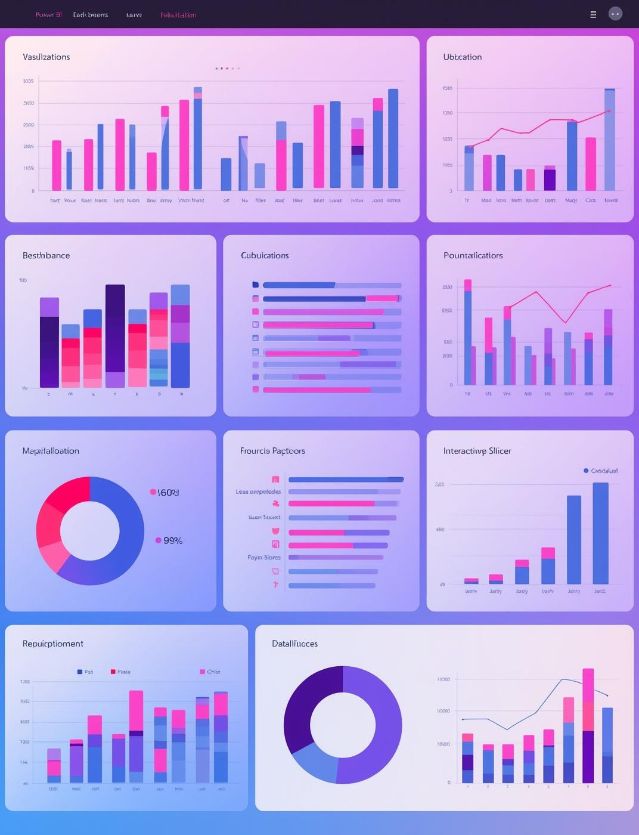
Power BI Dashboard
  Excel data imported into Power BI
  Visualizations used:
  Clustered Bar Chart (Average marks per student)
  Pie Chart (Performance status distribution)
  Slicer (Subject filter)
  Interactive dashboard for insights

Slide 6

AI Tools Overview
ChatGPT
Report structuring and content refinement
Grammarly
Technologies for Enhanced Student Performance Analysis
Grammar and readability improvement
Canva AI
Presentation design assistance
Google Drive
File sharing and teamwork
GitHub
Dataset and documentation management

Slide 7
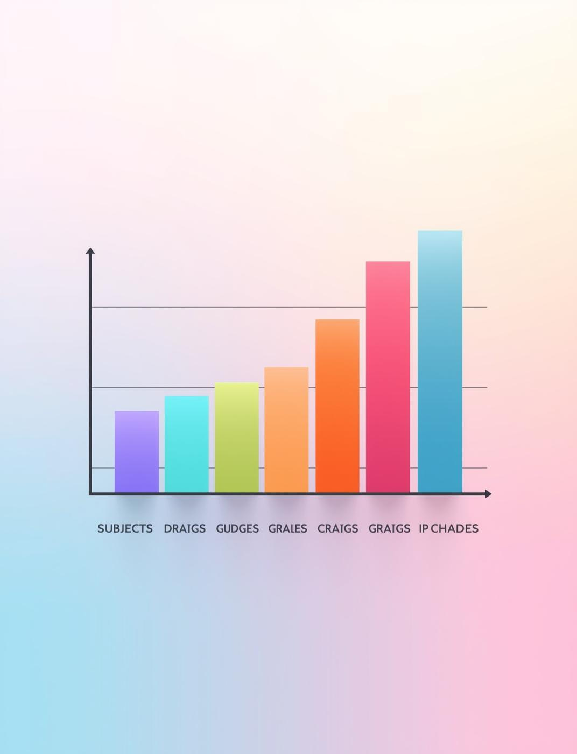
Results & Insights
The analysis revealed significant trends in student performance, highlighting areas for improvement and tailored interventions. Insights gained emphasize data-driven decision-making to enhance educational outcomes and support at-risk students.
  ICT subject shows better average performance
  Around 25–30% students need improvement
  Automation and dashboards improved efficiency

Slide 8

Thank You
Your questions are welcome here
Email
hello@reallygreatsite.com
Social Media
@reallygreatsite
Phone
123-456-7890

